Slide 1

Keeping Track of the Haverhill Line
CIT239-02HB
Marisha Kulseng
May 5, 2019

Slide 2
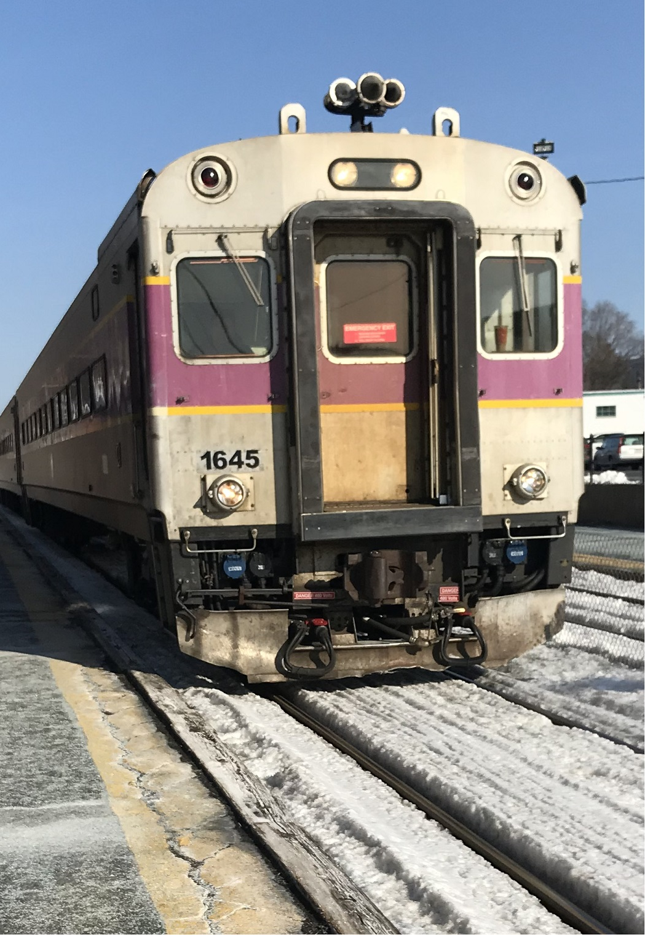
I. Project Objective
Become familiar with the use and function of public APIs
Fill the void left by the underwhelming Keolis app in terms of keeping track of train status

Slide 3
II. Team Members
Just me!

Slide 4
III. Definition of Terms
API – “Application program Interface” – “contains predefined classes and interfaces for developing Java programs” (Liang 11e)
JSON – “JavaScript Object Notation”
-a notation that packages data in arrays ([]) and objects ({}) (schoolofdata.org)
Gson– A Java library written by Google to assist in working with JSON

Slide 5
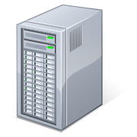
IV. Architecture Picture
MS Windows 10 OS
Internet
Java JVM
URL query
To API
Haverhill Tracker
Application
MBTA V3 API

Slide 6
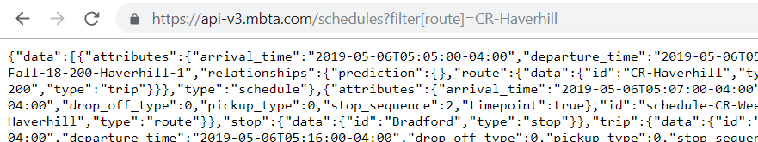
JSON and JSON viewer (I)
This is the actual URL we can use in our Java program to access the API’s data!
We can put it in an internet browser to see a text representation of the data

Slide 7
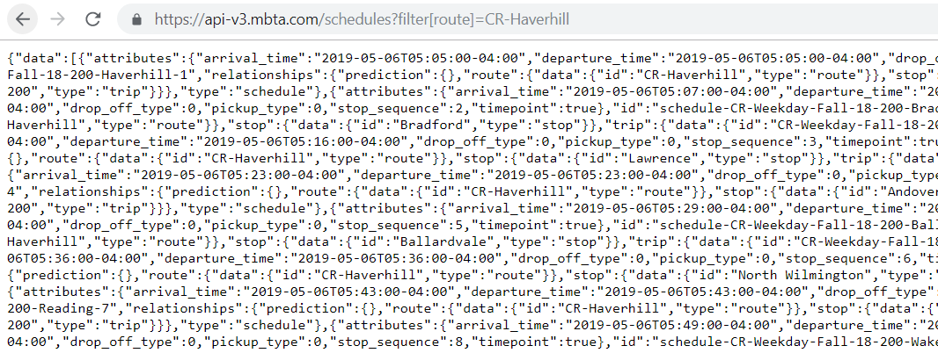
JSON and JSON viewer (II)
There has to be a better way!

Slide 8
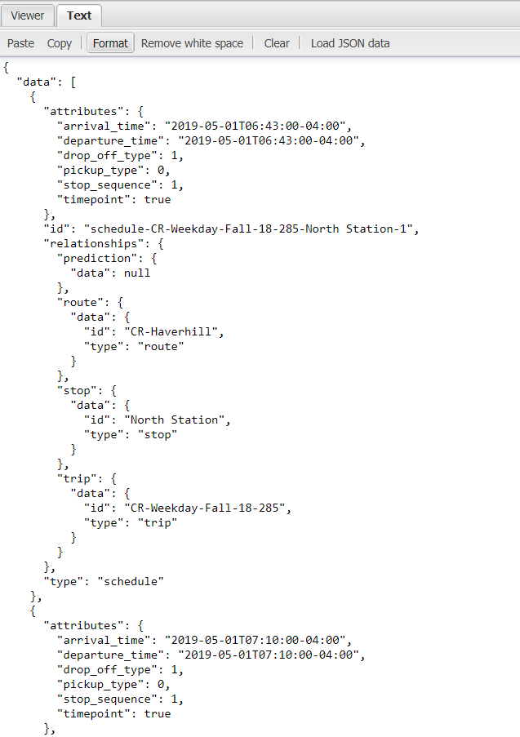
JSON and JSON viewer (III)
“Data” is an array that contains all of the information on this screen (and more!), and is denoted by [].
This indicates we need an array structure in our parsing class
Note of the names of these variables: they must be the same in our program (it is possible to override this)

Slide 9
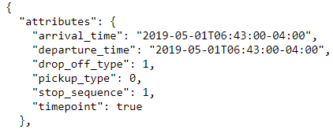
JSON and JSON viewer (IV)
“Attributes” is an object that contains information about departure times, arrival times, etc, and is denoted by {}
This indicates we need an “attributes” class in order to extract arrival/departure times

Slide 10
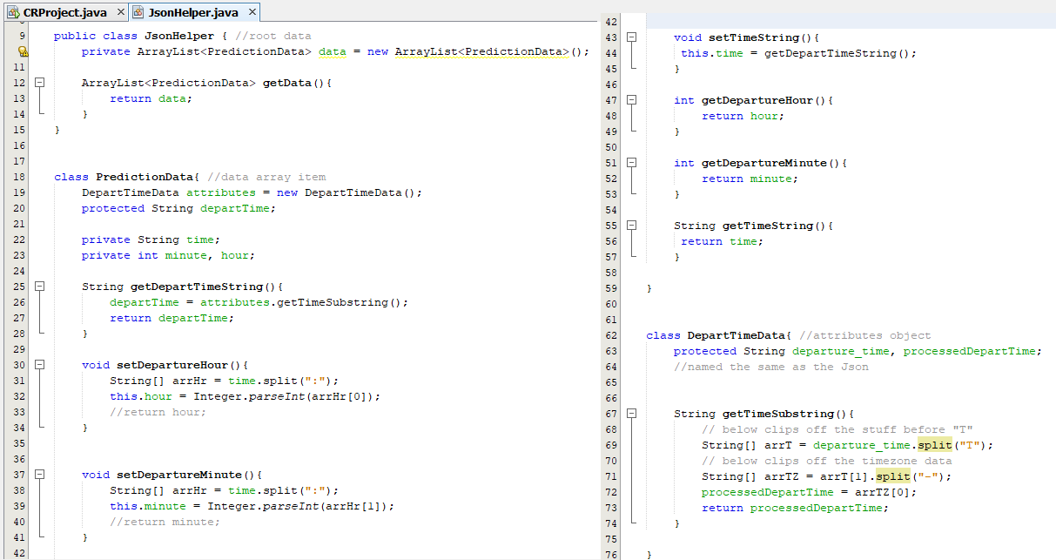
VI. Code – JsonHelper class

Slide 11
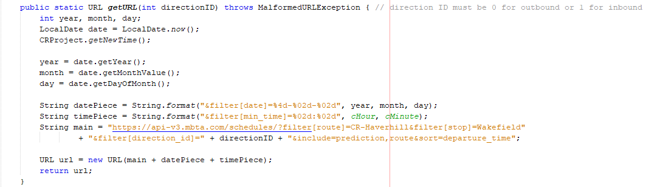
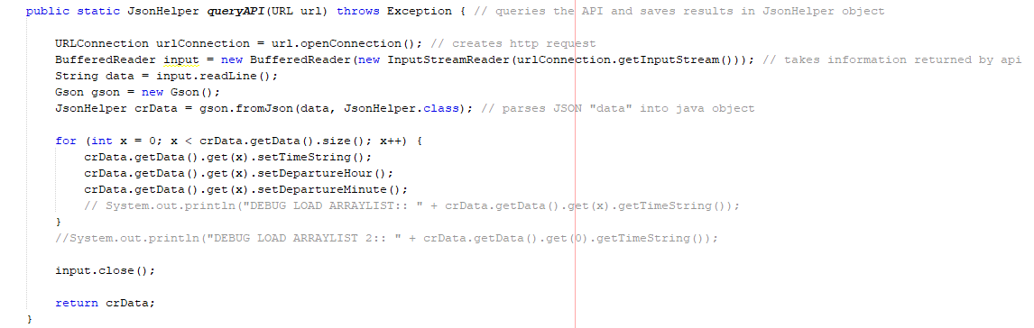
VI. Code – Calling and parsing API
Notes:
strOUT is the name of the majority of the string that is used in defining the URL (excludes date and time, mentioned elsewhere)
We need to piece together the string and declare it as a URL for the program
BufferedReader is the stream we use to be able to access the data the API sends back
dataOUT is the variable that holds what bufferedReader gets for us
We create a gson object and a JsonHelper object to parse the data from the JSON reply
For loop uses the information provided by the JSON to assign departure times for each object in an ArrayList in the JsonHelper class
Since we are sorting the data by departure time with our API call, the bestMatch index is 0, 2nd best is 1

Slide 12
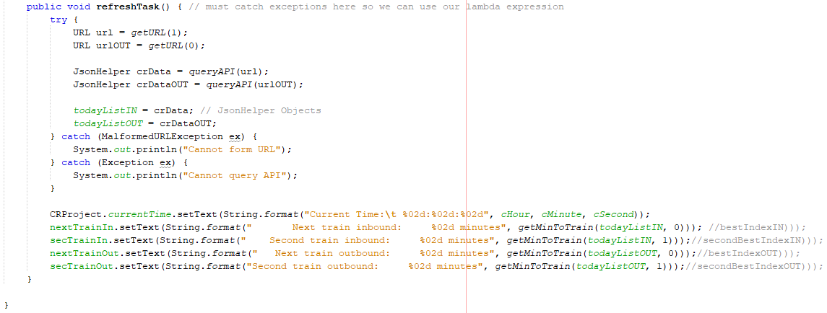
VI. Code – Refresh API Call
Notes:
is the function I created to take the data from the JsonHelper object and convert it to a number of minutes until the next train

Slide 13
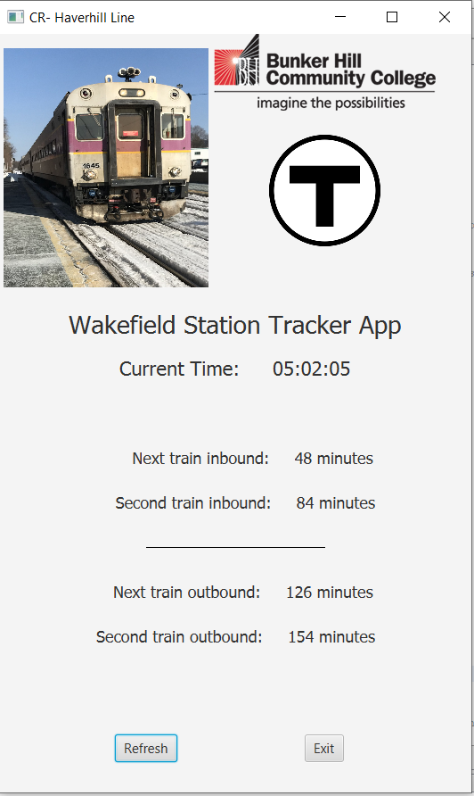
VII. Project Demo

Slide 14
VIII. Summary
Web APIs are tools developers can use to submit and retrieve data online
JSON is commonly used by web APIs to package data
We can use Java to interact with JSON and build more useful applications
Gson is a library created by Google to help with parsing data from JSON

Slide 15
References
com.google.code.gson. (n.d.). (Official GSON documentation.) Retrieved April 22, 2019, from
https://www.javadoc.io/doc/com.google.code.gson/gson/2.8.5
Jenkov, J. (2014, June 23). Java Networking: URL + URLConnection. Retrieved April 22, 2019, from
http://tutorials.jenkov.com/java-networking/url-urlconnection.html
JSON Viewer Tool. (n.d.). Retrieved March 3, 2019, from http://jsonviewer.stack.hu/
Liang, Y. D. (2017) Introduction to Java: Programming and Data Structures,
Comprehensive Version, 11th Edition. New York, NY: Pearson.
MBTA V3 API Documentation. (n.d.). Retrieved March 3, 2019,
from https://www.mbta.com/developers/v3-api
Official Java Language Documentation. (n.d.). Retrieved April 15, 2019, from
https://docs.oracle.com/javase/8/docs/api/index.html
Veltman, N. (2013, November 18). Web APIs for Non-Programmers. Retrieved March 3, 2019,
from https://schoolofdata.org/2013/11/18/web-apis-for-non-programmers
Veltman, N. (2013, November 21). XML and JSON: the Tale of the Tape. Retrieved March 3, 2019,
from https://schoolofdata.org/2013/11/21/xml-and-json/

Slide 16

Thank You!

